Slide 1

Basic Plots and Data Processing with Pandas

Slide 2
Read Carefully
For each week in-class exercises, assignment and/or homework, create a new Jupyter notebook with the following naming convention:
ID_Name_C(no.).ipynb
for example,
6619999_Johnwick_C2.ipynb

Slide 3
Basic plots

Slide 4
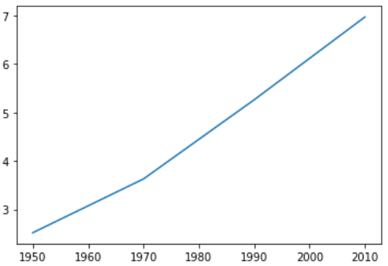
Basic plot: line plot
With matplotlib, you can create a bunch of different plots in Python. The most basic plot is the line plot. A general recipe is given here
Let’s create sample data and plot a graph
import matplotlib.pyplot as plt
plt.plot(x,y)
plt.show()
import matplotlib.pyplot as plt
%matplotlib inline
year = [1950, 1970, 1990, 2010]
pop = [2.519, 3.629, 5.263, 6.972 ]
plt.plot(year, pop)
plt.show() #display the plot

Slide 5
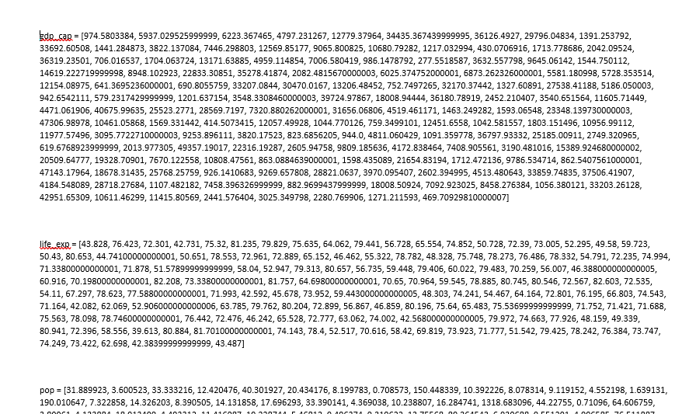
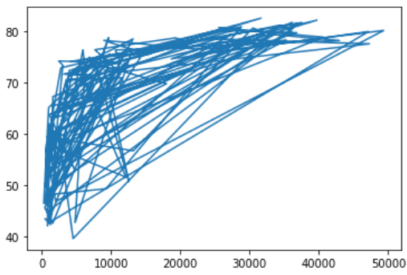
Basic plot: line plot (cont.)
Now let’s try with more data. Open the companion Word file, namely W2_dataset.docx, and copy the below three lists into your Jupyter notebook.
Now that we’ve built your first line plot, let’s start working on the data that Professor Hans Rosling used to build his beautiful bubble chart. It was collected in 2007. Three lists are available for you:
life_exp which contains the life expectancy for each country and
gdp_cap, which contains the GDP per capita (i.e., per person) for each country expressed in US Dollars.
pop, the population is in millions of people.
Try
When you have a time scale along the horizontal axis, the line plot is your friend. But in many other cases, when you're trying to assess if there's a correlation between two variables, for example, the scatter plot is the better choice. Below is an example of how to build a scatter plot.
# Make a line plot, gdp_cap on the x-axis, life_exp on the y-axis
# Display the plot

Slide 6
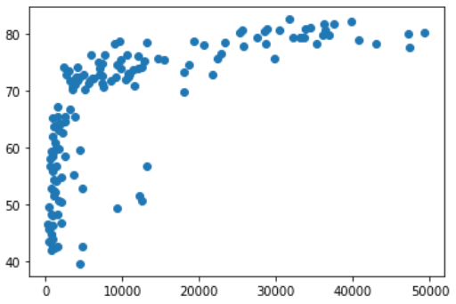
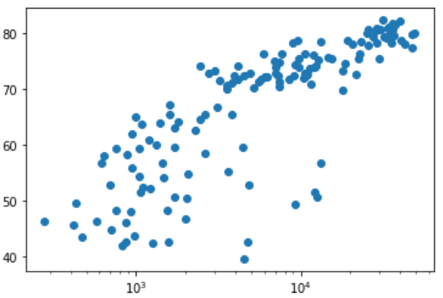
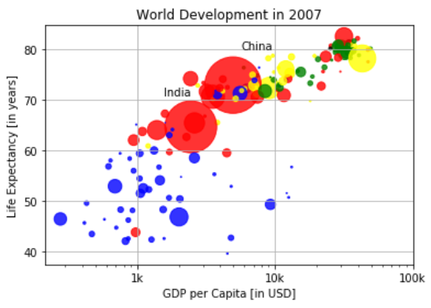
Basic plot: scatter plot
Try again with scatter plot. Change plt.plot to plt.scatter. Expected plot: You may also add plt.xscale(‘log’) to display the GDP per capita on a log scale.
Complete the following task:
From there we aim to later visualize ------ >
Build a scatter plot, where pop is mapped on the horizontal axis, and life_exp is mapped on the vertical axis.

Slide 7
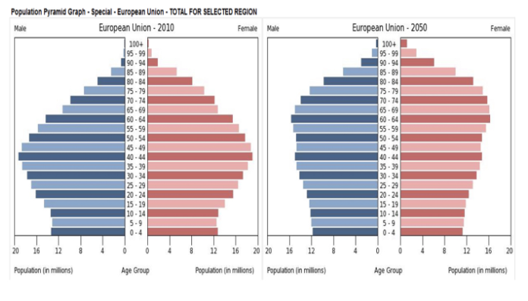
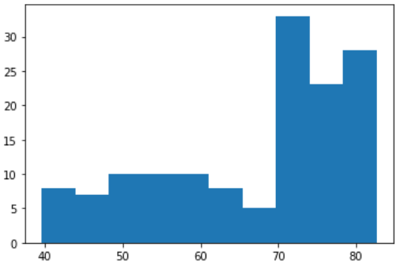
Basic plot: histogram plot (to explore data set and to get idea about distribution)
life_exp, the list containing data on the life expectancy for different countries in 2007. To see how life expectancy in different countries is distributed, let’s create a histogram of life_exp.
Try
We didn’t specify the number of bins. By default, Python sets the number of bins to 10 in that case. The number of bins is pretty important. Too few bins will oversimplify reality and won’t show you the details. Too many bins will overcomplicate reality and won’t show the bigger picture.
You can specify the number of bins by adding an argument bin = x, where x is the number of bins.
# Create histogram of life_exp data
plt.hist(life_exp, bins = )
# Display histogram
plt.show()

Slide 8
Complete the following tasks
Build a histogram of life_exp, with 5 bins. Can you tell which bin contains the most observations? Build another histogram of life_exp, this time with 20 bins. Is this better?
Now, copy the list, life_exp1950, to the Jupyter Notebook. Compare the life expectancy data for different countries in the years 1950 and 2007. Set the bins to 15. What do you observe? Which bin has the highest frequency?
Question 1) # answer the following questions in your Jupyter notebook (in the same cell)
1.1 ) You're a professor in Data Analytics with Python, and you want to visually assess if longer answers on exam questions lead to higher grades. Which plot do you use? (Line Plot, Scatter Plot or Histogram). Answer in Jupyter Notebook.
1.2) You're a professor in Data Analytics with Python, and you want to visualize a number of VMS intakes over the past 10 years. Which plot do you use? (Line Plot, Scatter Plot or Histogram). Answer in Jupyter Notebook.
1.3) You're a professor teaching Data Science with Python, and you want to visually assess if the grades on your exam follow a particular distribution. Which plot do you use? (Line Plot, Scatter Plot or Histogram). Answer in Jupyter Notebook.

Slide 9
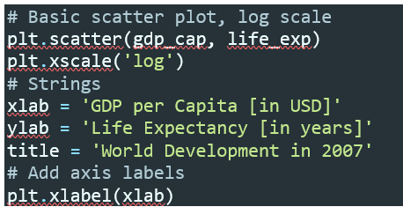
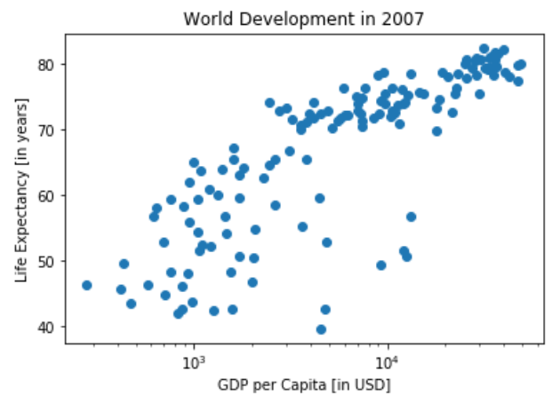
Labels
It’s time to customize our own plot. This is the fun part; we will see your plot come to life! Let’s work on the scatter plot with world development data: GDP per capita on the x-axis (logarithmic scale), life expectancy on the y-axis. As a first step, let’s add axis labels and a title to the plot.
We can do this with the xlabel(), ylabel() and title() functions, available in matplotlib.pyplot.
Add ylabel() and title() and show the graph.
Before
After
You will see that it is much clearer and easier to understand.

Slide 10
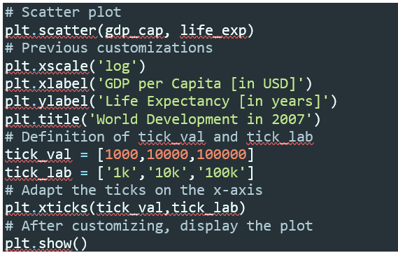
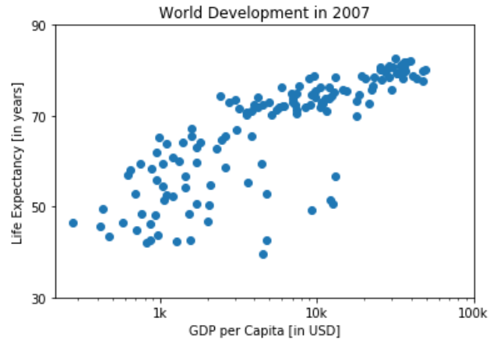
Ticks
We can control the y-ticks by specifying two arguments: plt.yticks([0,1,2], [“one”,”two”,”three”]). The ticks corresponding to the numbers 0, 1 and 2 will be replaced by one, two and three, respectively.
Let’s do a similar thing for the x-axis of our world development chart, with the xticks() function. The tick values 1000, 10000 and 100000 should be replaced by 1k, 10k and 100k.
Let’s set yticks to 30, 50, 70, 90. Plot the graph.

Slide 11
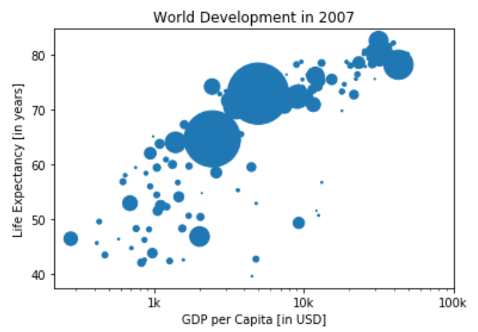
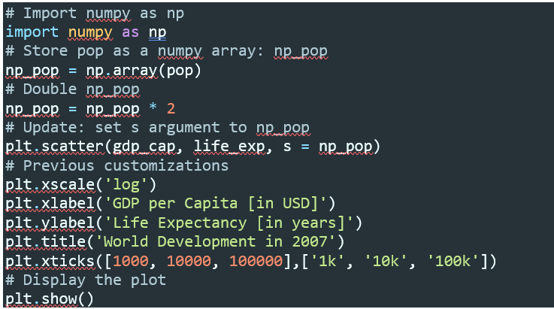
Sizes (resize dots)
Right now, the scatter plot is just a cloud of blue dots (some of you may get different color, but no worry), indistinguishable from each other. Let’s change this.
Wouldn’t it be nice if the size of the dots corresponds to the population? Now we need to use numpy package. Let’s import numpy as np and try to following code.

Slide 12
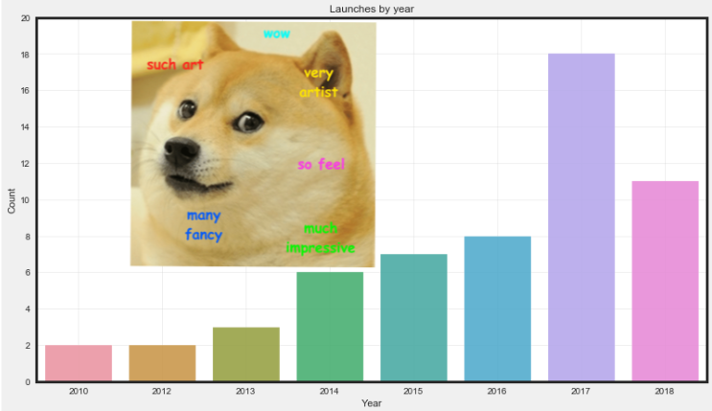
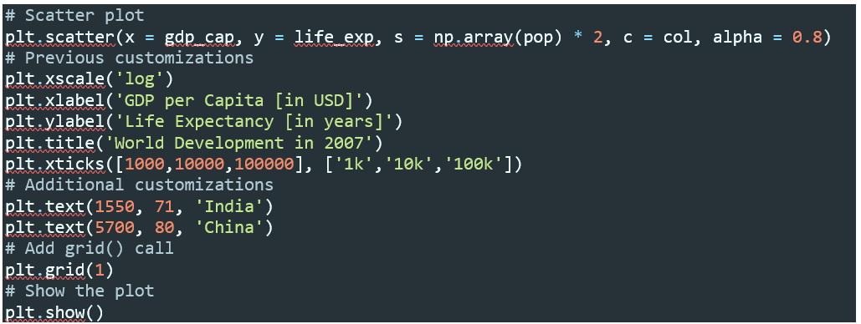
Colors
Remember visualization tips?? Use color purposefully.
The next step is making the plot more colorful! To do this, a list col has been created for you (it cannot be found in W2_dataset.docx).
It’s a list with a color for each corresponding country, depending on the continent the country is part of. If we have another look at the script, under # Additional Customizations, we’ll see that there are two plt.text() functions now. They add the words “India” and “China” in the plot.

Slide 13
Interpret Your Visualization
If you have a look at your colorful plot, it's clear that people live longer in countries with a higher GDP per capita. No high-income countries have really short life expectancy, and no low-income countries have very long-life expectancy. Still, there is a huge difference in life expectancy between countries on the same income level. Most people live in middle income countries where the difference in lifespan is huge between countries; depending on how income is distributed and how it is used.
What can you say about the plot? Which one is True?
The countries in blue, corresponding to Africa, have both low life expectancy and a low GDP per capita.
There is a negative correlation between GDP per capita and life expectancy.
China has both a lower GDP per capita and lower life expectancy compared to India.

Slide 14
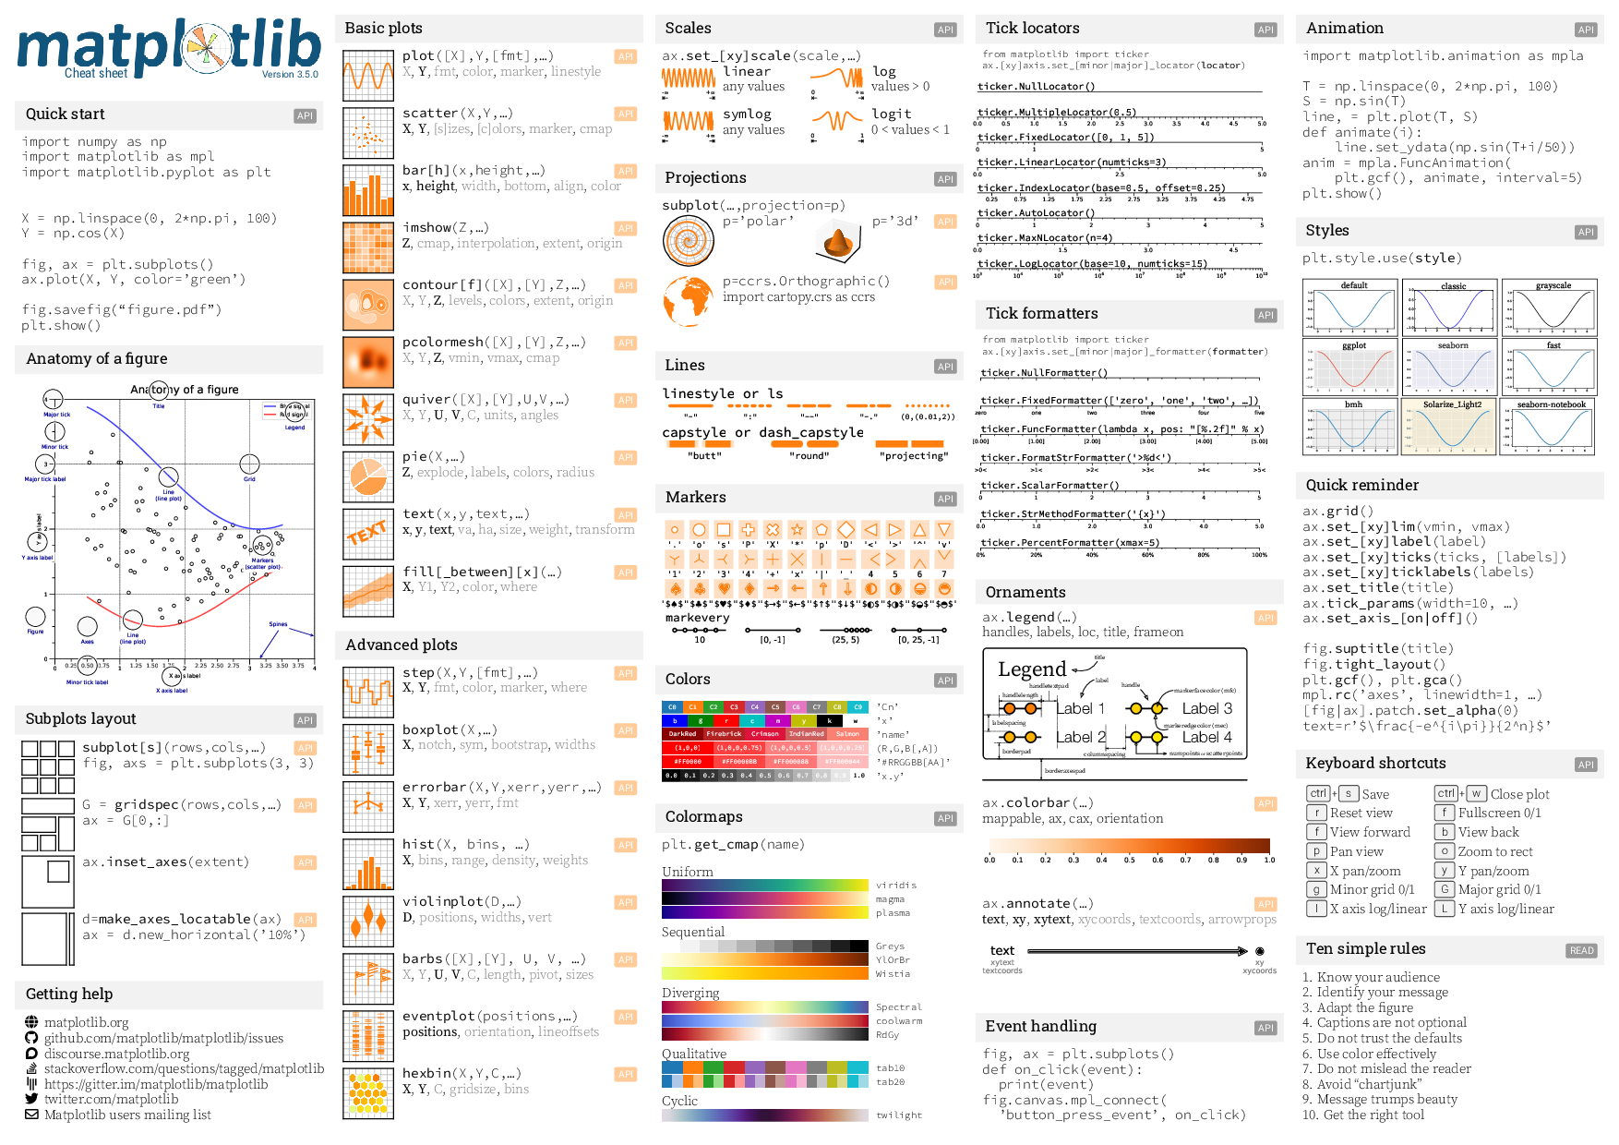
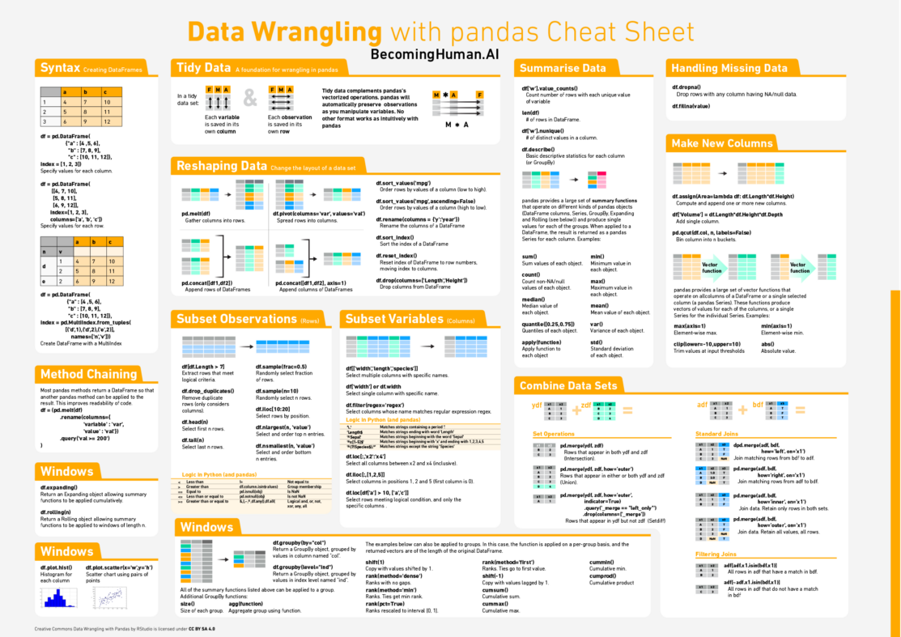
Cheat Sheets Help!!!!
https://medium.com/@anushka.datascoop/101-data-science-cheat-sheets-ml-dl-scraping-python-r-sql-maths-statistics-ef30b4d786eb
And many more….

Slide 15
Basic data processing with Pandas

Slide 16

What is Pandas?
What is Pandas? Pandas is a Python library used for working with data sets. It has functions for analyzing, cleaning, exploring, and manipulating data. The name "Pandas" has a reference to both "Panel Data", and "Python Data Analysis" and was created by Wes McKinney in 2008.
Not this Panda

Slide 17


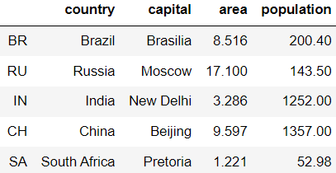
First Start with Pandas
We will start with loading structured data from .csv file. You need to import Pandas with pd.read_csv() command.
Let’s load the data from brics.csv to a variable, namely brics which is a dataframe variable (2D structure data). A command brics.head() will show the first five records.

Slide 18
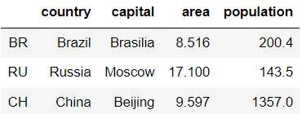

Assume that we want to select countries with an area over 8 sqr.km. Three simple steps are needed.
Select the area column.
Different ways – try
brics[‘area’]
brics.loc[:,’area’]
brics.iloc[:,2]
Do comparison on area column.
Use comparison operator and apply to selected column. Try
brics[‘area’] > 8, this will give you Boolean results.
Use result to select countries.
Apply the comparison results to dataframe.
Either assign the comparison result to a new variable first and apply it to the dataframe, i.e., result = brics[‘area’] > 8 then brics[result]
Apply the comparison directly to the dataframe i.e., brics[brics[‘area]>8]

Slide 19
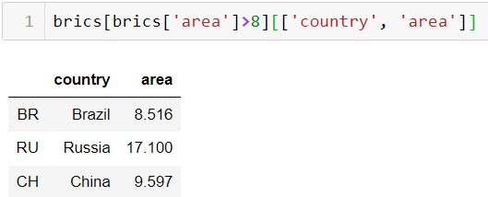
Only countries that area is > 8 are shown. Note that all columns will be displayed. To display some columns, we can do it by putting column’s name in the [ ] right after the above command. One good thing about Pandas is that commands are linear (in most cases). You can put one after the others. For example,
Complete the following task.
Show countries where the population is 200 or higher. Show data for columns; country and population.

Slide 20
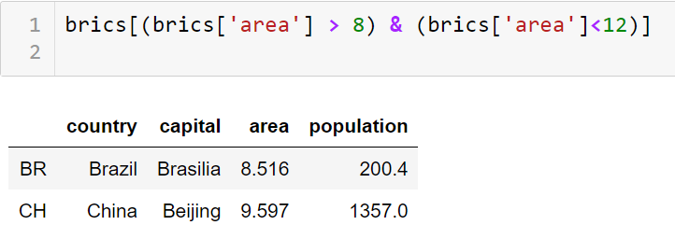
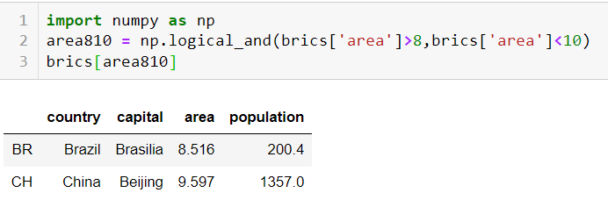
What if we want to choose a value in between. For example, area > 8 and area < 10. In Pandas, we can simply use brics[‘area’] > 8 and brics[‘area’] < 10. For example,
Note that you cannot use and/or, but instead you need to use | for or and & for and operator.
However, we can also use Numpy package. Let’s load numpy as np and try the following logical_and() command.
Just like earlier, brics[np.logical_and(brics['area']>8,brics['area']<10)] will also give you the same result.
Complete the following task.
Show country’s capital (only) that the population is over 1000 or area is less than 8. Expected output is New Delhi, Beijing, Pretoria.
Show the records (all columns) that the area is over 8 km²., and the population is between 100 – 500.

Slide 21
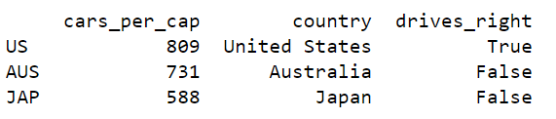

Let’s Practice!
Complete the following instructions. The data set, namely cars.csv, is provided.
Load cars.csv to cars dataframe.
Select the cars_per_cap column from cars as a Pandas Series and store it as cpc.
Use cpc in combination with a comparison operator > and 500 (for a column cars_per_cap). You want to end up with a boolean Series that's True if the corresponding country has a cars_per_cap of more than 500 and False otherwise. Store this boolean Series as many_cars.
Use many_cars to subset cars, similar to what you did before. Store the result as car_maniac.
Print out car_maniac to see if you got it right.
Create a DataFrame cpc100500, that includes all the observations of cars that have a cars_per_cap between 100 and 500. Then print cpc100500. (with and without Numpy)

Slide 22

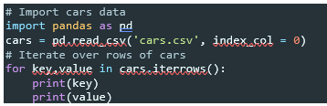

Loop over DataFrame
Iterating over a Pandas DataFrame is typically done with the iterrows() method. Used in a for loop, every observation is iterated over and on every iteration the row label and actual row contents. In this and the following exercises we will be working on the cars DataFrame. It contains information on the cars per capita and whether people drive right or left for seven countries in the world.
Observe what the result is. Just column name, isn’t it?
Try again with

Slide 23


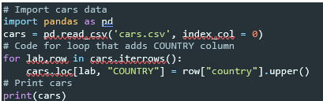
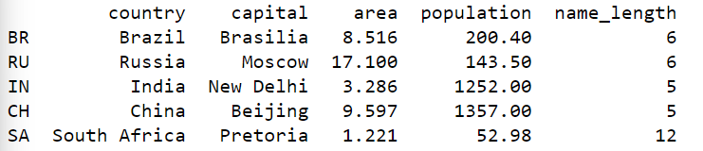
Add Column to DataFrame
The row data that’s generated by iterrows() on every run is a Pandas Series. This format is not very convenient to print out. Luckily, we can easily select variables from the Pandas Series using square brackets. Try
After loading the data, we can manipulate the data in many ways. Let’s start with adding a new column to cars. This adds a new column with label “COUNTRY” and we assign the country’s name (uppercase) to the corresponding field.
Now let’s add a new column, namely name_length, to brics and assign the length of each country’s name.

Slide 24

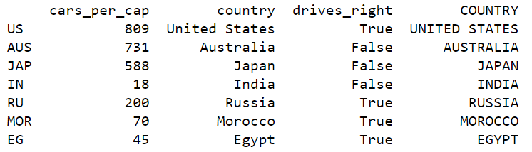
Apply() Function
Another approach if you want to calculate an entire DataFrame column by applying a function on a particular column in an element-wise fashion, is apply() function.
Let’s try .apply() to add a new column to cars. Use str.upper argument in apply().

Slide 25
Grouping and Sorting
To group categorial data, .groupby() method is used.
For instance, <dataframe>.groupby(‘gender’).count()
To sort data values, .sort_values(by = ‘col_name’)
For instance, <dataframe>.sort_values(‘age’)

Slide 26
Assignment
The provided data contains data sales info of a superstore. (W2_superstore_sales.csv).
The data contains, for example, Order_ID, Order_Date, Customer_ID, Customer_Name, etc.
To explore your data, you can use .info() function.
Load the data and explore
df = pd.read_csv('W2_superstore_sales.csv', index_col = 0)
df['Order_Date'] = pd.to_datetime(df['Order_Date'], errors='coerce')
df['Ship_Date'] = pd.to_datetime(df['Ship_Date'], errors='coerce’)
df['Order_Year'] = df['Order_Date'].dt.year
print(df.info())
The given code change Date columns to usable DateTime in pandas, and add Order_Year column to the DataFrame. You don’t need to worry much about the code now.

Slide 27
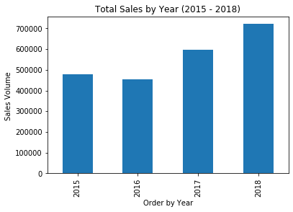
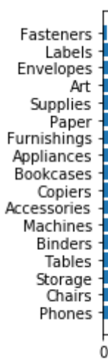
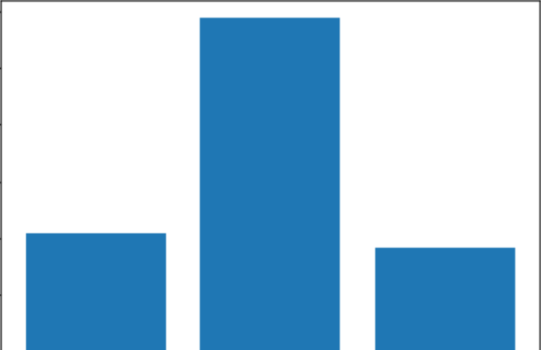
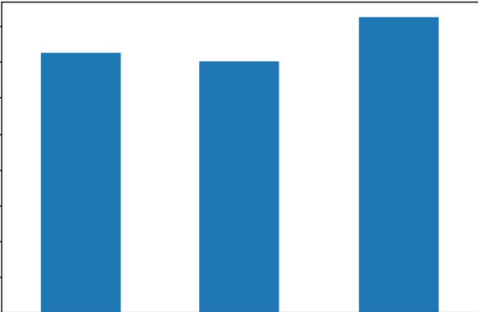
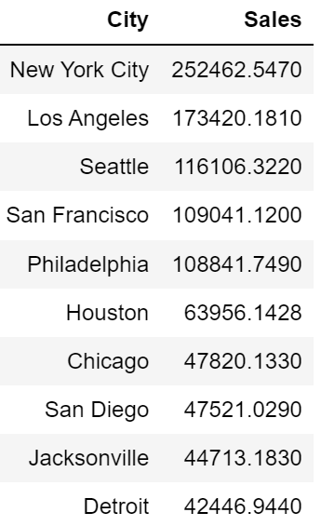
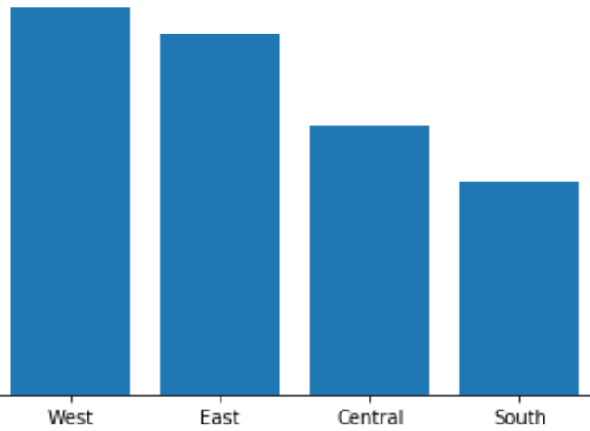
Complete the following tasks.
Find the total sales between year 2015-2018.
Plot a bar chart for Sales by Year. Title and labels must be provided.
Hint: you can plot a bar chart directly from the DataFrame or Series. For example, df.plot(kind=‘bar’)
Find out which product category has the highest sales amount (no. of order). A
Also plot a bar chart. Appropriate tile, labels must be included.
Find out which product category has the highest sales volumes (sales in USD).
Also plot a bar chart. Appropriate tile, labels must be included.
Plot the subcategory sales. Data must be sorted.
Plot sales by region.
Top 10 cities

Slide 28
Let’s Investigate Netflix Data
W2 – investigating Netflix Data.docx

